Slide 1


Mike Ames amesam@wfu.edu
Wake Forest
School of Business
_______
Decision Trees & Classification

Slide 2
Classification
Classification is the task of assigning objects/records to one of several predefined categories or classes.
Binary Classification – 2 outcomes i.e. Yes / No, True / False, 0/1
Spam Detection
Categorizing Cells as benign or malignant based on an MRI
Predicting Loan Default / Churn / Fraud / Response etc.
Multi-Class/Multi-Label – more than 2 outcomes, ex. Apple/Orange/Banana, Bird/Cat/Dog/Squirrel etc.
Examples are classified as belonging to one among a range of known classes
Digit Recognition
Facial Recognition
Optical Recognition

Slide 3
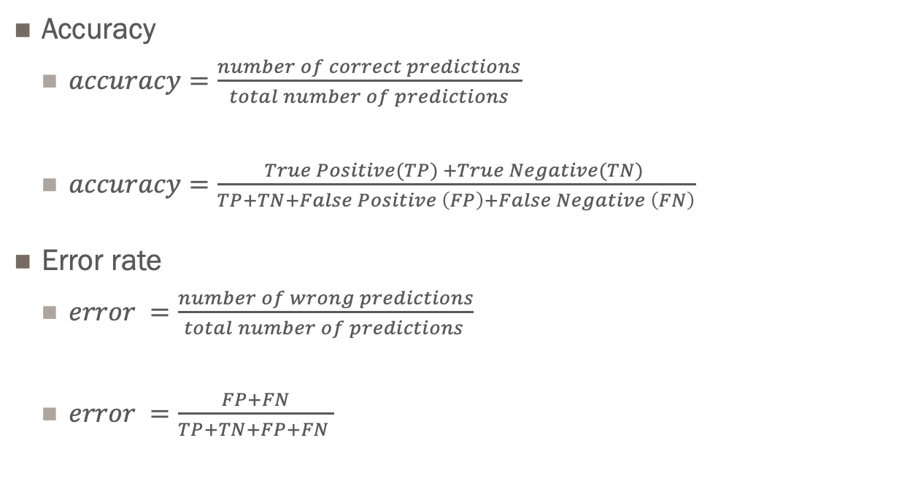
Binary Classification
Evaluation Accuracy & Error
Accuracy
$accuracy=\frac{number of correct predictions}{total number of predictions}$
$accuracy=\frac{True Positive(TP) +True Negative(TN) }{TP+TN+False Positive \left(FP\right)+False Negative \left(FN\right)}$
Error rate
$error =\frac{number of wrong predictions}{total number of predictions }$
$error =\frac{FP+FN}{TP+TN+FP+FN }$
Accuracy is a good measure IF the data is balanced i.e. 50/50 split between classes, in that case expected accuracy is 50% a coin flip for example.
The reality is that most problems are imbalanced meaning a majority and a minority case ex. 10:1, 100:1 in which case you can be 90 – 99% right by assigning everyone to the majority case.

Slide 4
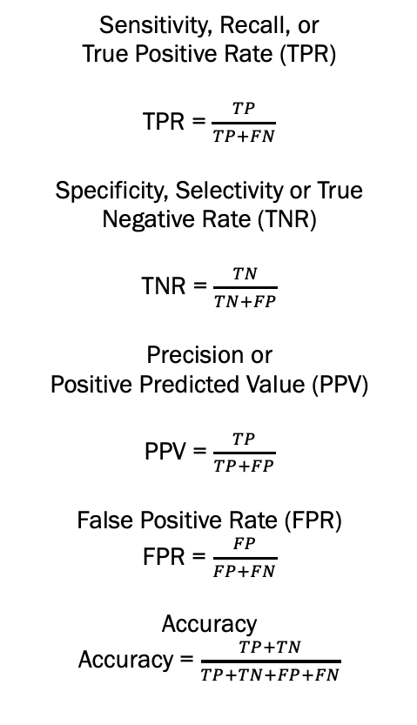
Binary Classification
Confusion Matrix
Sensitivity, Recall, or
True Positive Rate (TPR)
TPR = $\frac{TP}{TP+FN}$
Specificity, Selectivity or True Negative Rate (TNR)
TNR = $\frac{TN}{TN+FP}$
Precision or
Positive Predicted Value (PPV)
PPV = $\frac{TP}{TP+FP}$
False Positive Rate (FPR)
FPR = $\frac{FP}{FP+FN}$
Accuracy
Accuracy = $\frac{TP+TN}{TP+TN+FP+FN}$
 |  | Actual Class
 |  | False(0) | True(1)
Predicted Class | False (0) | True Negative (TN) | False Negative (FN)
 | True (1) | False Positive (FP) | True Positive (TP)

Slide 5
Binary Classification
To further confuse, classes are often flipped.
Sensitivity, Recall, or
True Positive Rate (TPR)
TPR = $\frac{TP}{TP+FN}$
Specificity, Selectivity or True Negative Rate (TNR)
TNR = $\frac{TN}{TN+FP}$
Precision or
Positive Predicted Value (PPV)
PPV = $\frac{TP}{TP+FP}$
False Positive Rate (FPR)
FPR = $\frac{FP}{FP+FN}$
Accuracy
Accuracy = $\frac{TP+TN}{TP+TN+FP+FN}$
 |  | Actual Class
 |  | True (1) | False(0)
Predicted Class | True (1) | True Positive (TP) | False Positive (FP)
 | False (0) | False Negative (FN) | True Negative (TN)
https://en.wikipedia.org/wiki/Confusion_matrix

Slide 6
Simplest form of Classification
Business Rule
IF < Condition(s) Met > THEN
<CLASS LABEL > = 1
ELSE
<CLASS LABEL > = 0
Naïve Approach is to use “ I think, I feel”
IF < something I think is true but can’t prove > THEN …

Slide 7
Drive it with Data
Business Rules cont…
IF contract == “Month-to-month” THEN
Churn = Yes
ELSE
Churn = No
In simple terms anything that has a higher PCT than the default will detect more of that event. So here the default churn rate is 27% the rule above identifies 47% churn

Slide 8
Drive it with Data
Business Rules cont…
Creating multiple business rules based on data is one way
Rule 1
IF cust_serv_cols >= 5
THEN Churn = True.
ELSE Churn = False.
Rule 2
IF cust_serv_cols >= 5
AND day_mins < 149
THEN Churn = True.
ELSE Churn = False

Slide 9
What the heck is a decision tree?
Root Node
Decision node
Leaf Node
Leaf Node
Decision node
Leaf Node
Leaf Node

Slide 10
What the heck is a decision tree?
True. = 483
False. = 2850
P_true = 0.145
Cust_serv_calls
True. = 421
False. = 2811
P_true = 0.13
Day_mis
True. = 287
False. = 2704
P_true = 0.096
True. = 137
False. = 107
P_true = 0.556
True. = 62
False. = 39
P_true = 0.62
Day_mins
True. = 35
False. = 2
P_true = 0.946
True. = 27
False. = 37
P_true = 0.422
IF cust_serv_calls >=5
< 5
>= 5
AND day_mins > 260 THEN P_churn = 0.556
ELSE P_churn = 0.096
AND day_mins < 150 THEN P_churn = 0.946
ELSE P_churn = 0.422
<= 260
> 260
< 150
>= 150

Slide 11
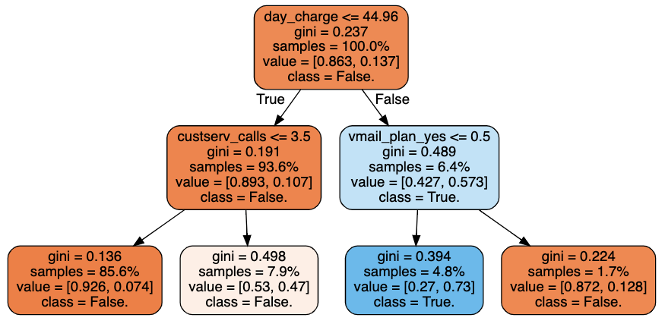
Churn Decision Tree

Slide 12
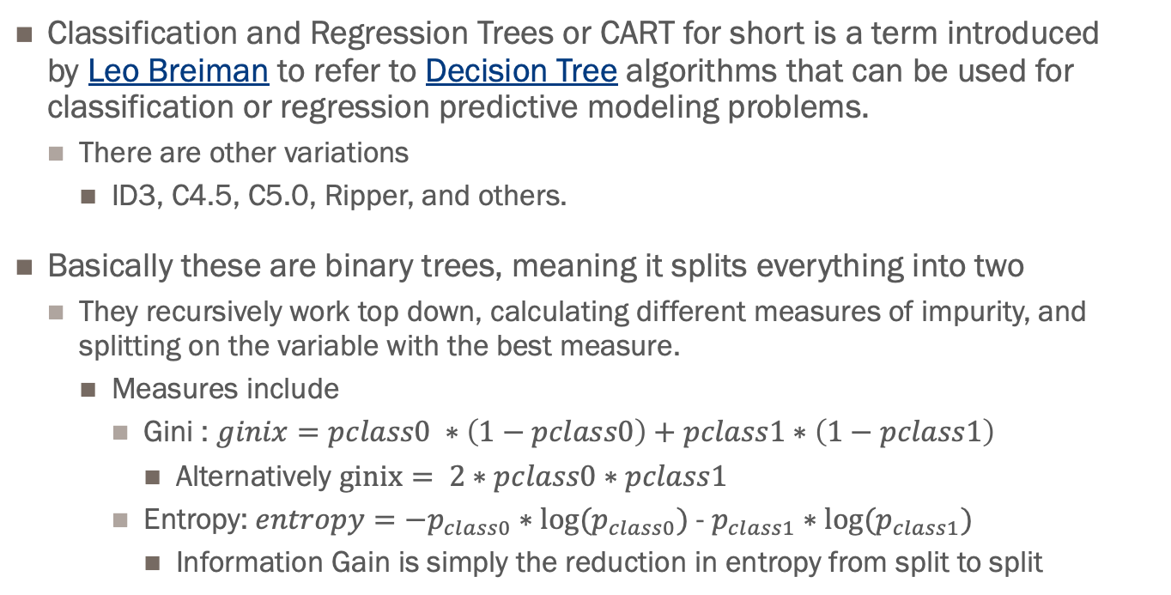
About Trees.
Classification and Regression Trees or CART for short is a term introduced by Leo Breiman to refer to Decision Tree algorithms that can be used for classification or regression predictive modeling problems.
There are other variations
ID3, C4.5, C5.0, Ripper, and others.
Basically these are binary trees, meaning it splits everything into two
They recursively work top down, calculating different measures of impurity, and splitting on the variable with the best measure.
Measures include
Gini : $ginix=pclass0 ∗\left(1−pclass0\right)+pclass1∗\left(1−pclass1\right)$
Alternatively $ginix= 2∗pclass0∗pclass1$
Entropy: $entropy={−p}_{class0}∗log⁡(p_{class0})$ - $p_{class1}∗log⁡(p_{class1})$
Information Gain is simply the reduction in entropy from split to split

Slide 13
Decision Tree
Hyperparameters
Split Criteria ~ criterion, {“gini”, “entropy”}, The function to measure the quality of a split
Split Strategy ~ splitter, {“best”, “random”}, strategy used to choose the split at each node
Tree Depth ~ max_depth, maximum depth of the tree.
Min Samples Split ~ min_samples_split, minimum number of samples to be eligible for splitting
Min Samples Leaf ~ min_samples_leaf, minimum number of data points in a node that are required for the node to be split further. A split point at any depth will only be considered if it leaves at least min_samples_leaf
Minimal Cost Complexity ~ ccp_alpha, Minimal cost-complexity pruning is an algorithm used to prune a tree to avoid over-fitting. Default is 0 i.e. no pruning.
https://scikit-learn.org/stable/modules/generated/sklearn.tree.DecisionTreeClassifier.html

Slide 14
Decision Tree Tuning
Two other things
Trees are “weak learners”
Very sensitive to data
Different samples yield different results
Balancing data
Messing with the sampling can yield different results
Removing columns
Removing initial split columns often will give better or similar results

